Slide 1

Black Hat 2016
Las Vegas

Slide 2
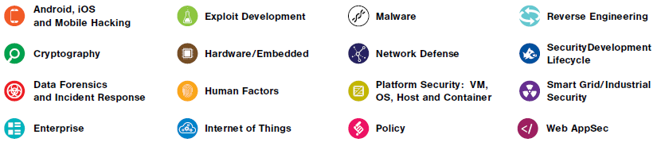
Overview
Numerous sessions: more than 50 a day

Slide 3
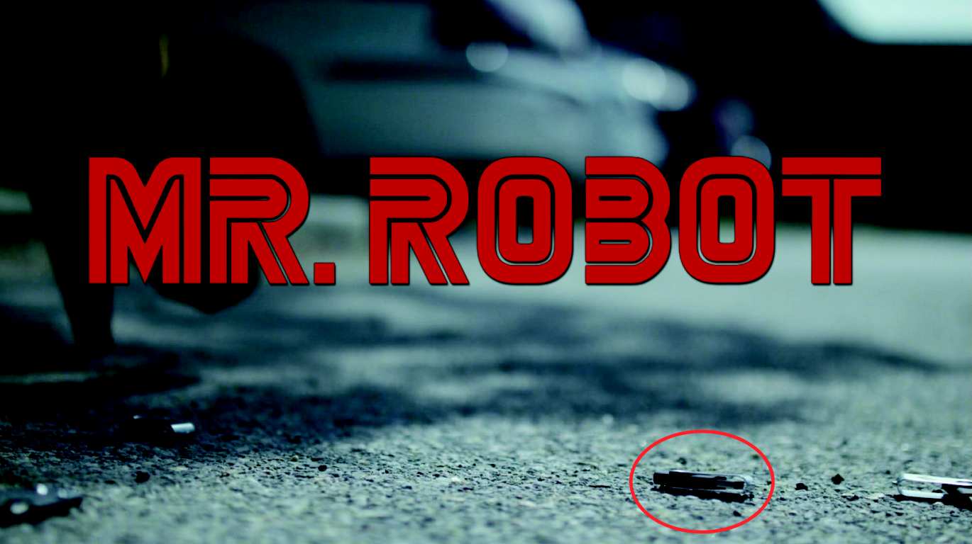
Dropping USB Drives
Does dropping usb drives really work?

Slide 4
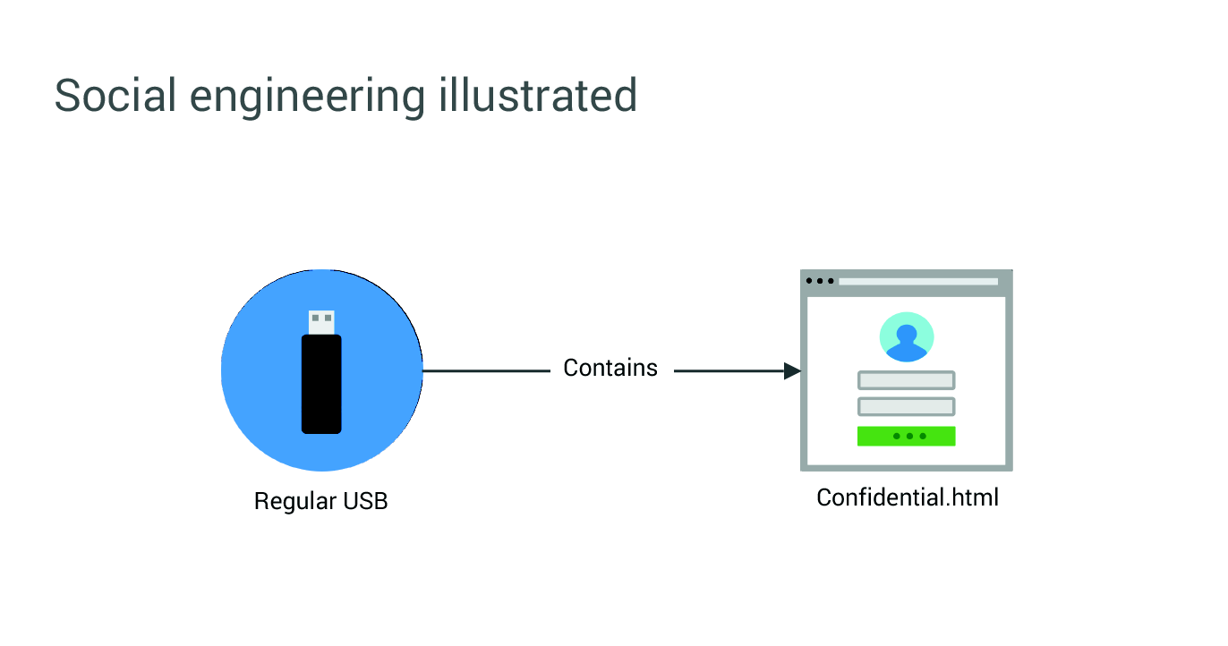
Attacks via USB Drive

Slide 5
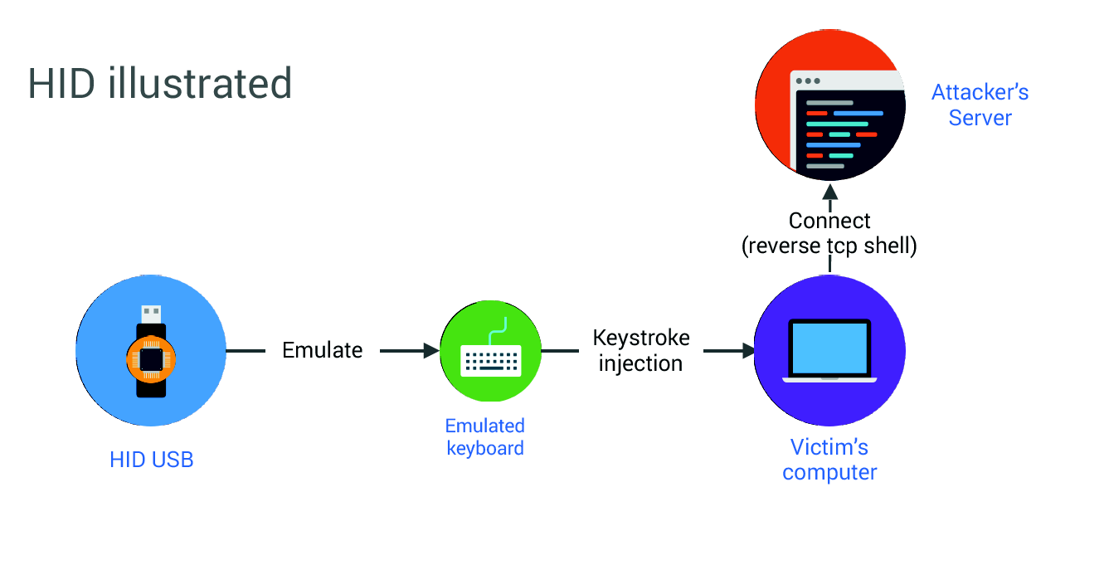
Attacks via USB Drive

Slide 6
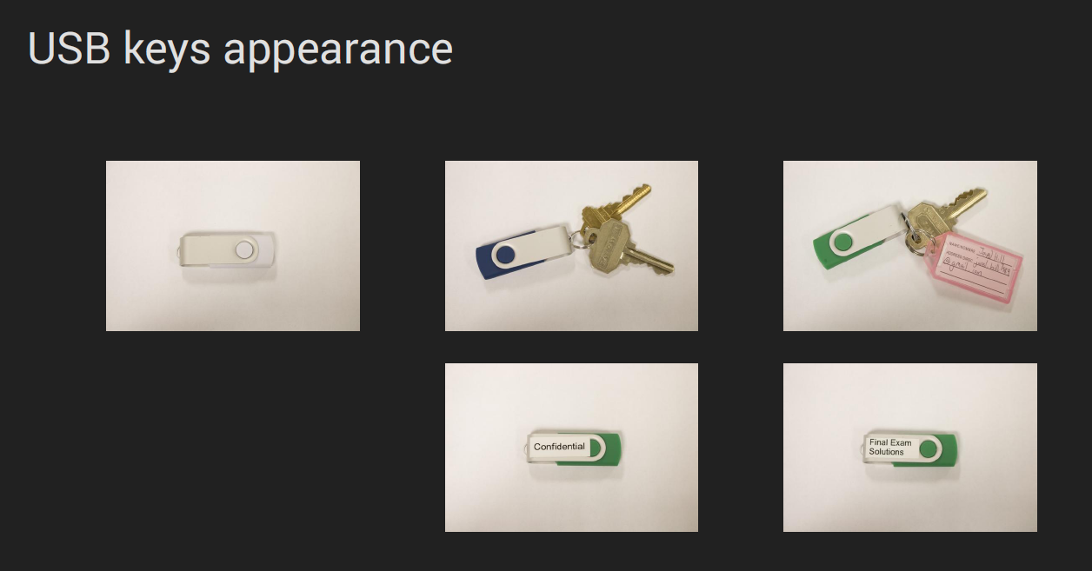
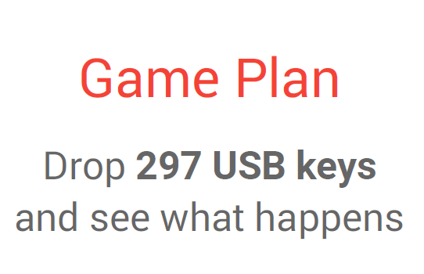
USB Drive Attacks

Slide 7
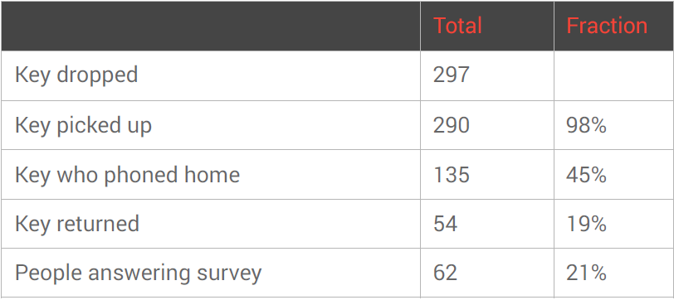
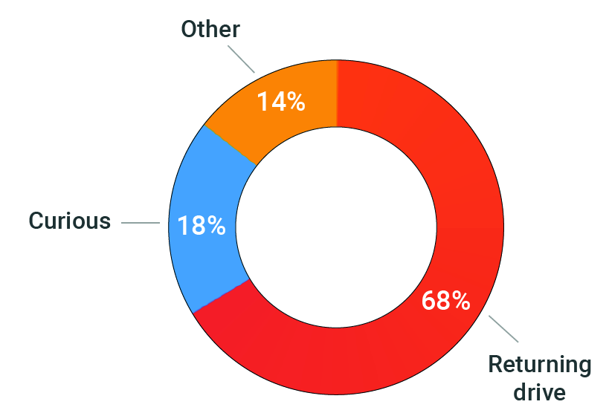
USB Drive Attack

Slide 8


AI for Security
Cylance, invincea, …
Traditional approaches to malware detection are hard to tune.
Automatic (re)tuning will improve attribution and reduce cost.

Slide 9
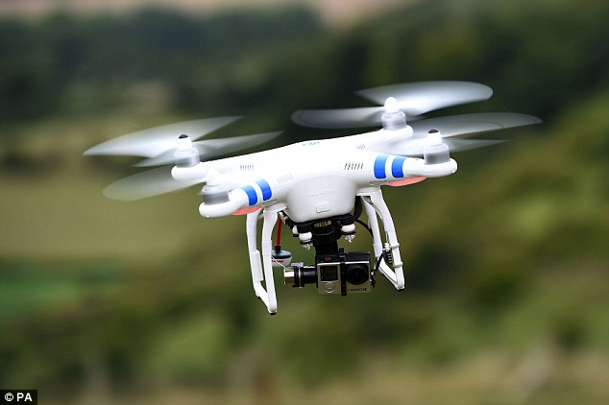
Killer Drone!
Drone Attacks on Industrial Wireless: A New Front in Cyber Security
https://www.youtube.com/watch?v=6Viwwetf0gU

